Slide 1
TypeScript
Creating and Using Funtions
Lecture 3
By James(Jin) Wang
11/15/2021

Slide 2
Outline
Foundations of functions
Parameters and return values
Synchronous and asynchronous
Products demo

Slide 3
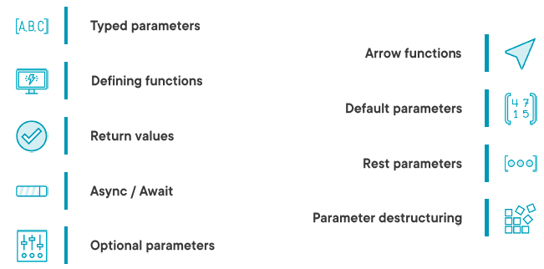
Foundations of Functions
  Building Apps with Functions:

Slide 4
Parameters and return values
  Specifying Typed Parameters:
  Demo: Typed Parameters

Slide 5
Parameters and return values
  Defining Functions:
  Demo: Define Function

Slide 6
Parameters and return values
  Return Values:
  Demo: Return Values

Slide 7
Parameters and return values
  Asynchronous Functions:
  Demo: Async Fun

Slide 8
Parameters and return values
  Arrow Functions:
  Demo: Arrow Fun

Slide 9
Parameters and return values
  Optional Parameters:
  Demo: Optional Params

Slide 10
Parameters and return values
  Default Parameters:
  Demo: Default Params

Slide 11
Parameters and return values
  Rest Parameters:
  Demo: Rest Params

Slide 12
Parameters and return values
  Parameters Destructuring:
  Demo: Param Destructure

Slide 13
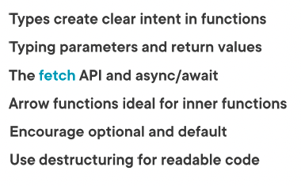
Summary

Slide 14
Assignment

Slide 15
Self Study
  Typescript Core Language Path
  TypeScript: Getting Started
  https://app.pluralsight.com/library/courses/getting-started-typescript

